Slide 1

Subject Code
PT I - INTERDISCIPLINARY PROJECT
PROJECT TITLE
1. Pattan Abdul Kalam [ Reg.No. : 39110756 ]
2. Pattan Abdul Kalam [ Reg.No. : 39110756 ]
Internal Guide
Dr. R. Sathya Bama, M.E., Ph.D.,

Slide 2
PRESENTATION OUTLINE
COURSE CERTIFICATE
ABSTRACT
OBJECTIVES
SYSTEM ARCHITECTURE
PROJECT IMPLEMENTATION
RESULTS AND DISCUSSIONS
RESULT SNAPSHOTS
CONCLUSION & FUTURE WORK
REFERENCES

Slide 3

COURSE CERTIFICATE

Slide 4
ABSTRACT
Diabetes is a chronic disease that is caused due to the inability of the production of insulin by the body.
Early prediction of such disease helpful for control over it.
To achieve this goal we gathered a diagnostic dataset having 17 attributes of 520 patients.
Based on this attributes, we figured to use Random Forest Classifier Algorithm for the diabetes prediction.
Random Forest is a ensemble learning model that operates by constructing a multitude of decision trees at training time

Slide 5
OBJECTIVES
To develop a system which can perform early prediction of diabetes with a good accuracy .
To accomplish this we gathered a diagnostic dataset from UCI consists of 17 attributes of 520 instances.
After examine the dataset we decided to implement Random Forest Classifier algorithm.
We used python language for machine learning because of its features which makes it easier to build models for ML.

Slide 6
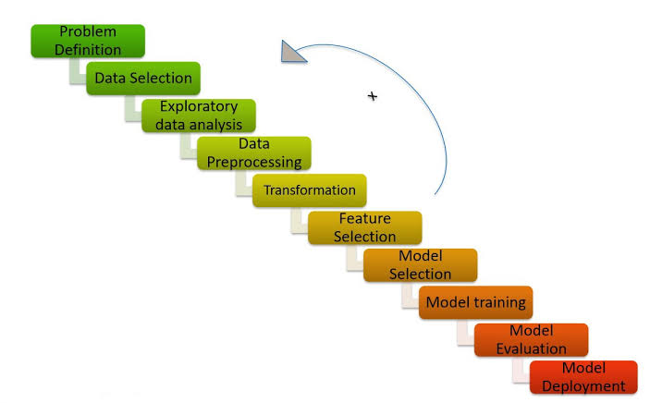
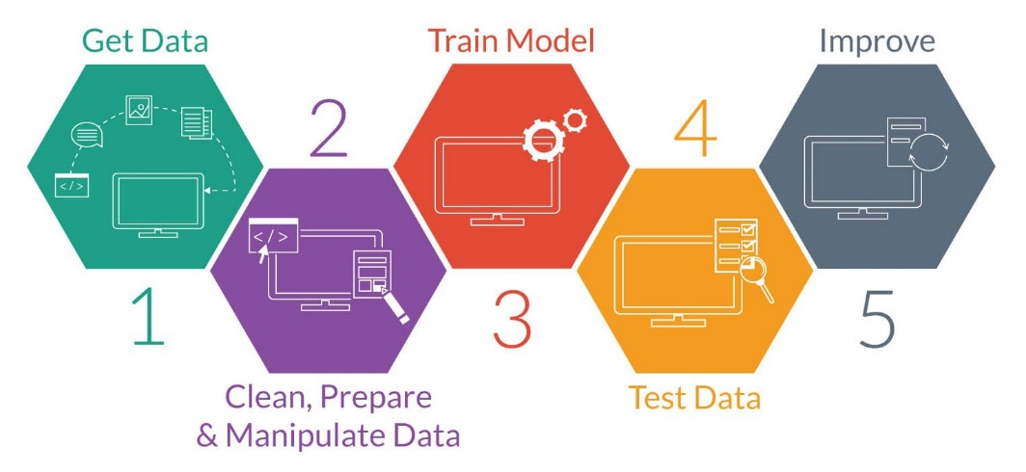
SYSTEM ARCHITECTURE

Slide 7
HARDWARE AND SOFTWARE REQUIREMENTS
Software Requirements
  Jupyter Notebook - Project environment
  Pandas – Convert dataset into data-frame
  Matplot , Seaborn – Used to visualize the dataset
  SkLearn module – To import all types ML algorithms
Hardware Requirements
  GPU
  Any Operating System

Slide 8
DATASET DESCRIPTION
To implement this project we need to follow the below steps
  GetData :
      Gather the diagnostic dataset of 520 patients.
  DataCleaning :
      Check for Null values, replace with mean value of column.
  DataPreprocessing :
      Divide the data into features(x) and label(y).
  Train and Test:
      Split the dataset into train(80%) and test(20%).
  Model Selection :
      Implement Random Forest Classifier for given data set.
  Model Evaluation :
      Check Classification Metrics.

Slide 9
CLASSIFICATION ALGORTIHM
We choose random forest classifier model because, prediction feature is a discrete class label. Random forest classifier is a ensemble learning model that operates by constructing a multitude of decision trees at training time.
For classification tasks the output of the random forest is the class selected by most trees so that our accuracy will also be high.
From SkLearn.ensemble we import Randomforest classifier into our Model
Model.fit () is used for training model and Model.predict() is used for prediction

Slide 10
RESULTS AND DISCUSSION
Confusion matrix and it’s related metrics given a good score, by this we can conclude that our model performed well.
This model is pretty good because by implementing all the steps above mentioned we got an accuracy equal to 99%.Therefore,it is a good model and our predictions will be effective .

Slide 11
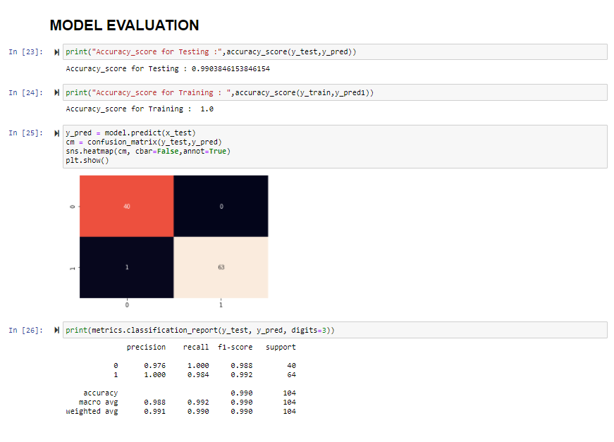
RESULTS AND DISCUSSION

Slide 12
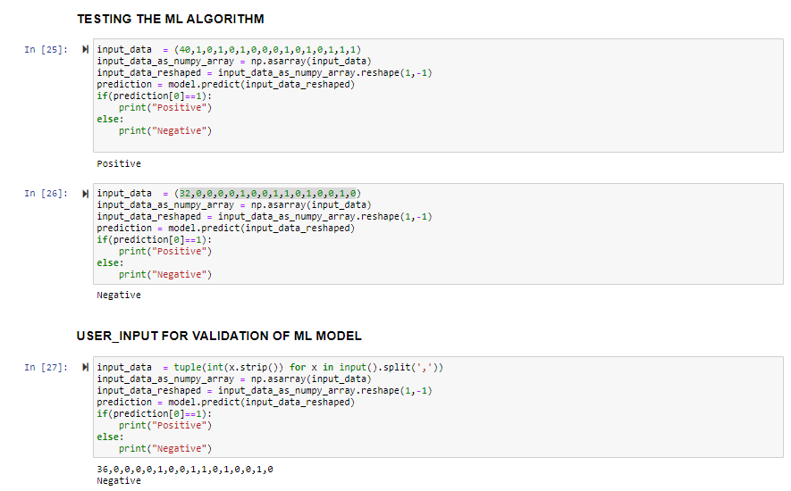
RESULTS AND DISCUSSION

Slide 13
CONCLUSION & FUTURE WORK
Machine learning approaches work well for diagnosis of diabetes. It performs very well with medical datasets. Prediction of diabetes at early stage helps the patient in order to provide appropriate treatment.
I had taken a wide range of research about different ML Algorithms and finally choose random forest classifier approach to solve this problem.
In this project we implement random forest classifier approach and we observed that it given a good accuracy and performed well.
In the process of research, I came to know about the various ML techniques and it’s different algorithms which helps to solve real-world problems.

Slide 14
REFERENCES
https://archive.ics.uci.edu/ml/datasets/Early+stage+diabetes+risk+prediction+dataset.
https://www.healthline.com/health/diabetes.
https://www.python.org/doc/
https://scikit-learn.org/stable/.
https://towardsdatascience.com/understanding-random-forest-58381e0602d2.

Slide 15

EARLY-STAGE DIABETES RISK PREDICTION

Slide 16

EARLY-STAGE DIABETES RISK PREDICTION

